Slide 1
Shortest distance
d

Slide 2
Shortest distance
d

Slide 3
Shortest distance
d

Slide 4
Hausdorff distance

Slide 5
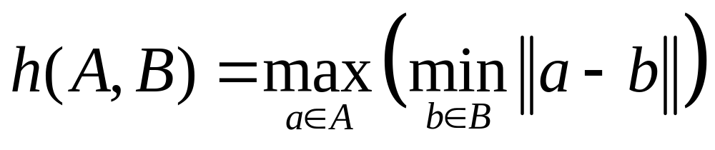
Hausdorff
A
h(A,B)
forward distance
B

Slide 6
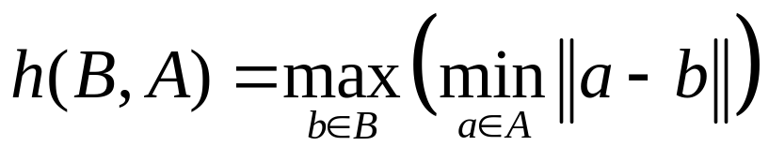
Hausdorff
A
B
h(B,A)
backward distance

Slide 7
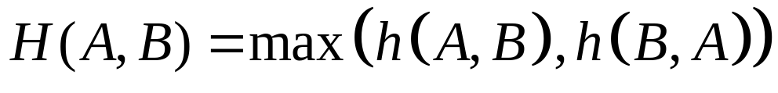
Hausdorff
A
h(B,A)
backward distance
B
h(A,B)
forward distance

Slide 8
Hausdorff
A
H(A,B)
B

Slide 9
Hausdorff

Slide 10
Hausdorff
d

Slide 11
Hausdorff
d

Slide 12
Hausdorff
d

Slide 13
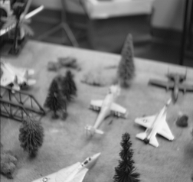

Application

Slide 14
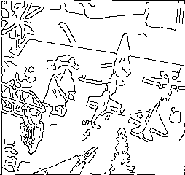

Application

Slide 15
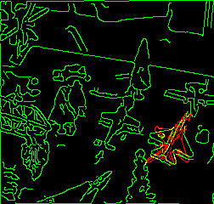
Application

